Slide 1
GROUNDWATER AVAILABILITY ASSESSMENT IN THE KUMI SUB-BASIN (EASTERN UGANDA)
JOHN ILIMA
MSCIV (Candidate)
College of Engineering, Design, Art and Technology
MAKERERE UNIVERSITY- KAMPALA.

Slide 2
INTRODUCTION
Fresh water is a key strategic resource for Uganda’s economic development.
Key challenges:
Climate change impacts (droughts, floods,etc)
Water shortages
Quality deterioration
Skewed understanding on availability
Poor management
Kumi is already a victim of all these!
Policy Brief

Slide 3
INTRODUCTION (cont’d)
Surface sources-more erratic
Groundwater-a critical resource in the area:
Reliance for daily supply has grown exponentially-rapid extraction campaign
Sustainability- a key concern
Hydrogeological conditions and behavior of watershed is not well understood.
Policy Brief

Slide 4
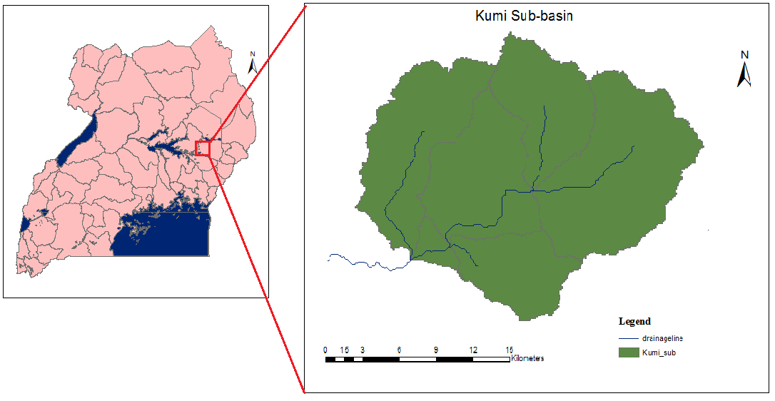
METHOLOGY
A 90 m resolution Digital Elevation Model geo-referenced and processed in ArcGIS 10.1 to delineate the basin.
Figure 1: Kumi Sub-basin
Policy Brief

Slide 5
METHOLOGY
Meteorological, lithological, groundwater level and pumping test data were collected, synthesized and analyzed to prepare various model inputs.
Recharge flux was estimated using Chloride Mass Balance (Bear & Verruijt, 1987)
Conceptual model constructed prior to numerical modeling.
Policy Brief

Slide 6
METHOLOGY
A steady-state numerical groundwater model developed and calibrated using PMWIN 5.3 (Chiang & Kinzelbach, 1998).
Sensitivity analysis of the model carried out.
Policy Brief

Slide 7
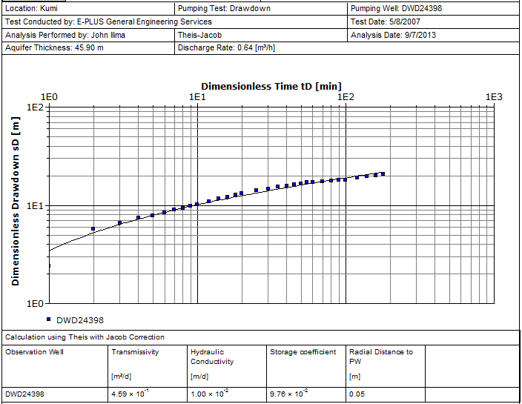
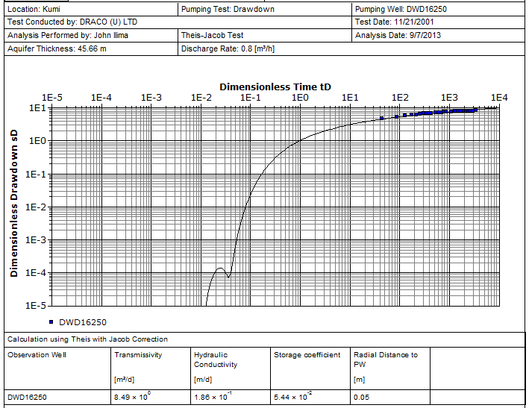
FINDINGS
Kumi aquifer system is of fractured-rock type average transmissivity of 5.12 m²/day.
Policy Brief

Slide 8
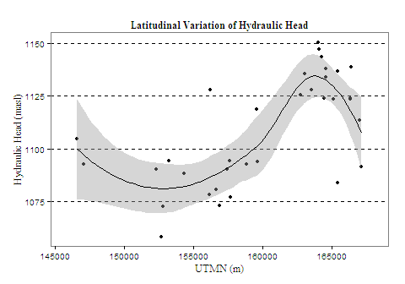
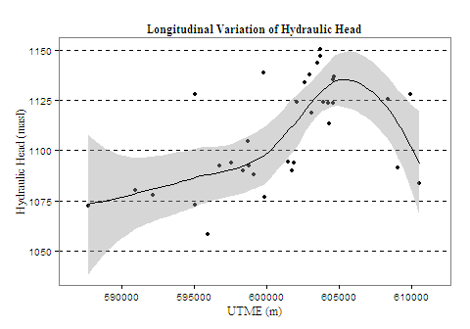
FINDINGS (cont’d)
Groundwater flows towards the central plain of the basin, with resultant discharge being to the southwest.
Policy Brief

Slide 9
FINDINGS (con’t)
Average recharge ranges 74-126 mm/year representing about 6-10% of average annual rainfall.
Model more sensitive to transmissivity and recharge. And more sensitive to recharge reduction than increment.
Policy Brief

Slide 10
RECOMMENDATIONS
Focused studies on the geological structure and fissure system of basin be undertaken.
Techniques: VES, EM traversing, radon Gas surveys
Economically feasible methods to improve supply be developed and piloted.
Angled drilling & collector wells
Detailed study of the central reach of the basin, as a potential wellfield be undertaken.
Policy Brief

Slide 11
END OF PRESENTATION
THANK YOU FOR LISTENING
Policy Brief

